Slide 1

KALLAM HARANADHAREDDY INSTITUTE OF TECHNOLOGY (AUTONOMOUS)
DEPARTMENT OF INFORMATION TECHNOLOGY

Slide 2

Emotion Based Music Recommendation System
Presented By :
218X1A1237- Sk. Sohel
218X1A1243- V. Manideepa
218X1A1248- A. Sai Pavan
218X1A1250- D. Vamsi Krishna
Under the supervision of :
Mr. K. R. M. C. SEKHAR
M. Tech., (PhD.,)
Department of I.T

Slide 3
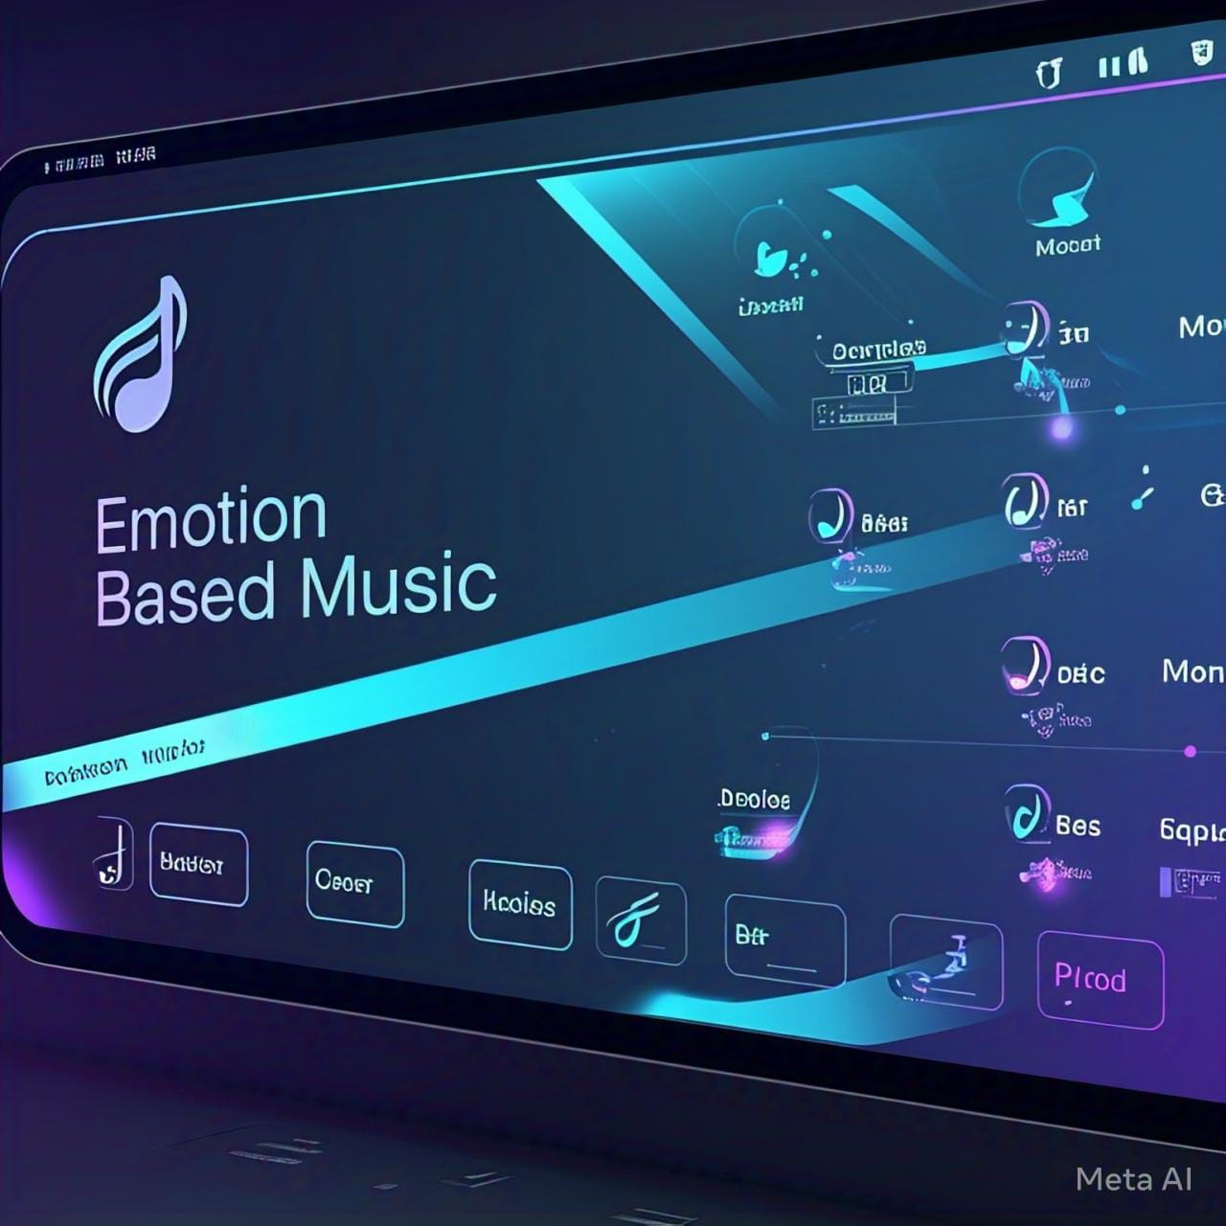
Table of Contents
1.Abstract
2.Introduction
3.Literature Survey
4.Existing System
5.Drawbacks in Existing System
6.Proposed System
7.Requirements
8.System Architecture
9. UML Diagrams
10.Testing
11.Output Screens
12.Conclusion
13.Future Enhancements
14.Bibliography
15.References

Slide 4
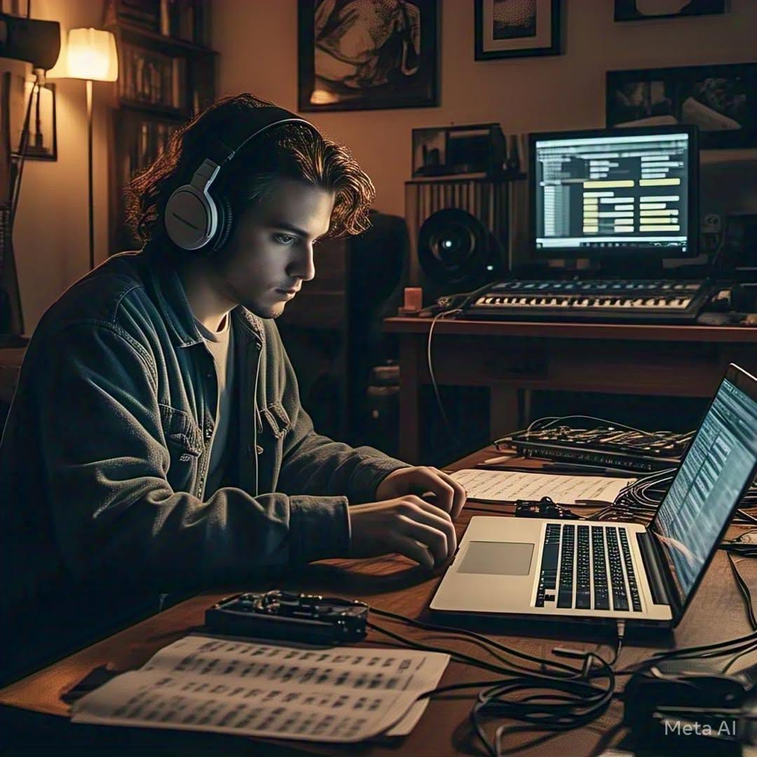
Abstract
Music profoundly impacts humans and is widely utilized for relaxation, mood regulation, stress relief, and enhancing mental and physical performance. As a result, humans share a strong and meaningful connection with music.
Facial expression plays a vital role in predicting human emotions and mood. Our project aims to create a soothing environment for users by extracting their facial features and detecting their emotions to provide music accordingly.

Slide 5
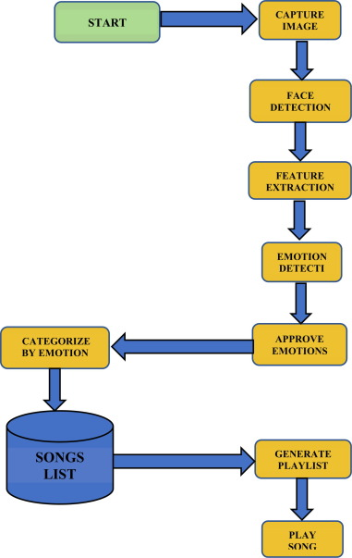
Introduction
A system that uses computer vision techniques to detect and analyze facial expressions in order to extract emotional features is known as an emotion-based music recommendation system using facial emotions. These features are then used to recommend music that corresponds with the user's current emotional state.
NOTE: This is hard for blind and deaf people . Because the blind people can’t show there expressions clearly and the deaf people can’t hear the songs .So, It is very hard for blind and deaf persons .
Figure 1: Step by Step process

Slide 6
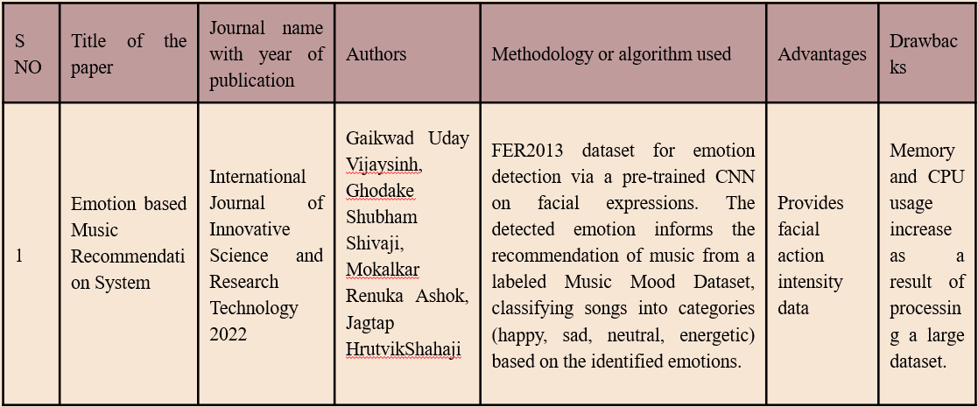
Literature Survey

Slide 7
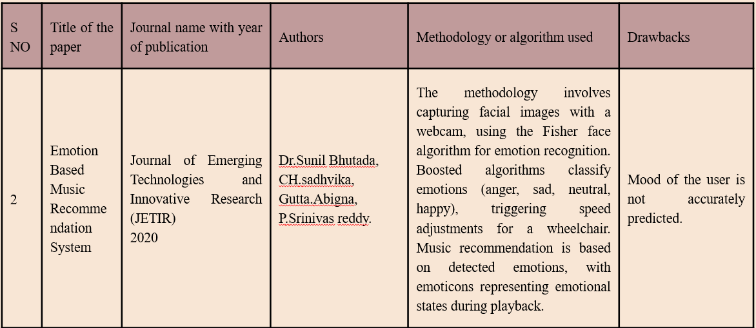
Literature Survey

Slide 8
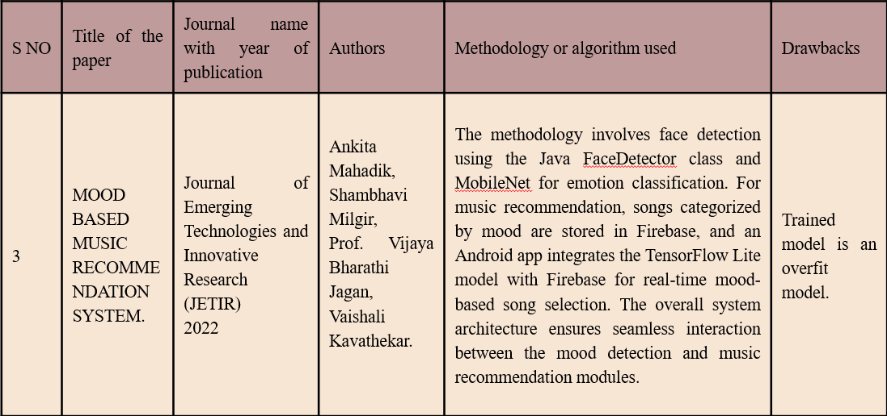
Literature Survey

Slide 9
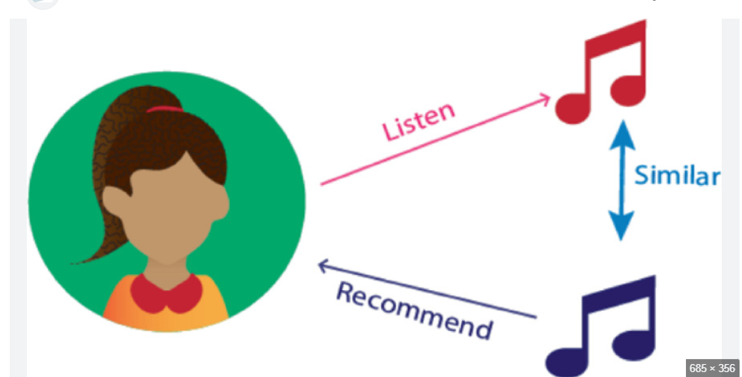
Existing System
Traditional music recommendation systems use collaborative filtering or content-based filtering.
They recommend songs based on user history, ratings, or genre preferences.
These systems do not consider the user’s emotions while suggesting songs.
Figure 2:Existing System

Slide 10
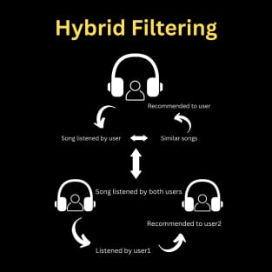
Existing System
Hybrid Filtering System :
The most widely used approach, combining Collaborative Filtering and Content-Based Filtering for accurate and personalized recommendations.
Figure 3 Hybrid filtering system

Slide 11
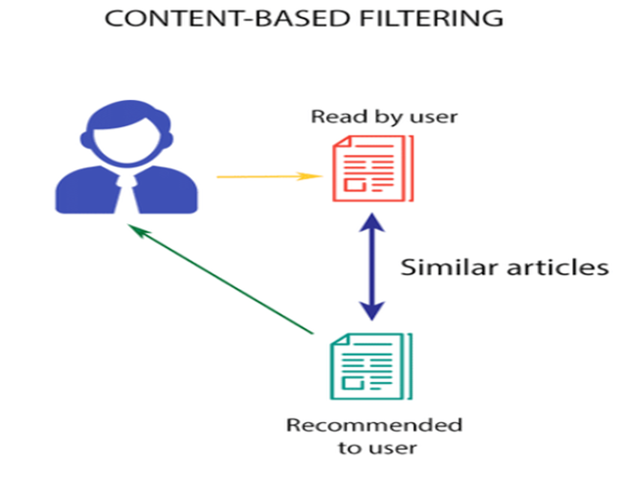
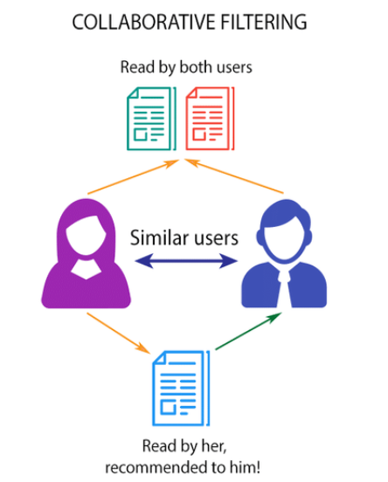
Content-Based Filtering
Analyses song features (genre, tempo, lyrics) to recommend similar songs.
Does not rely on other users’ data.
Example: Apple Music’s personalized playlists.
Collaborative Filtering
Recommends songs based on user preferences and listening history.
Uses data from similar users to suggest music.
Example : Spotify& YouTube Music’s recommendation engine.
Figure 4 Content based filtering
Figure 5 Collaborative filtering

Slide 12
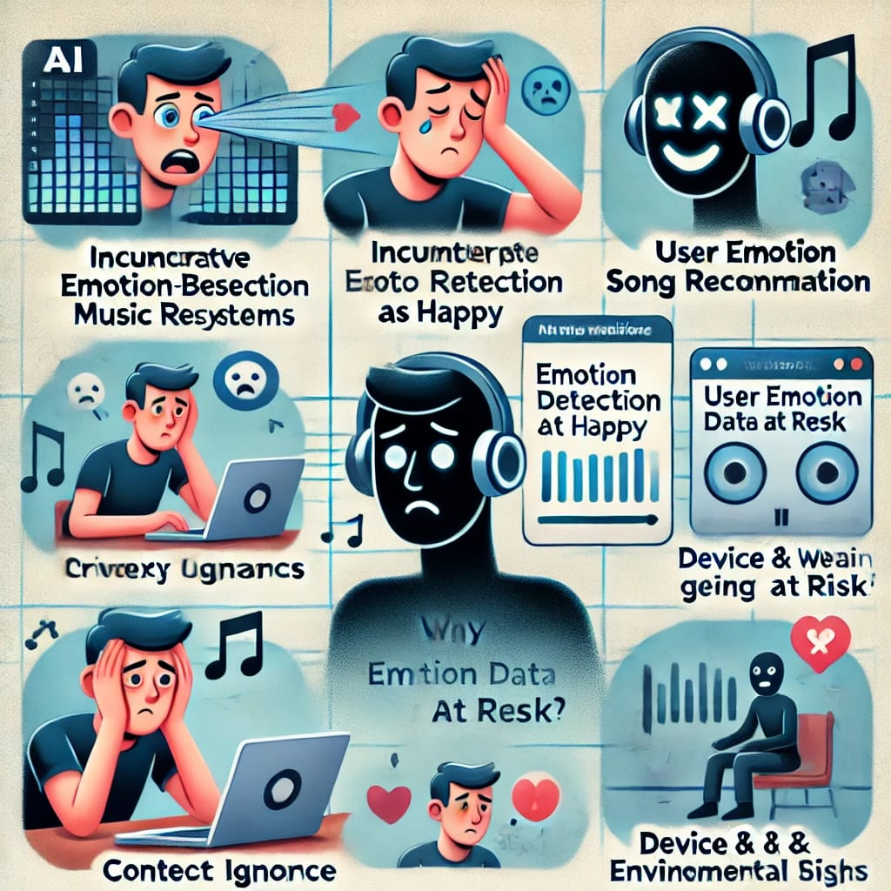
Drawbacks in Existing System
Memory and CPU usage increase as a result of processing a large dataset.
Mood of the user is not predicted.
Trained model is an overfit model.
No better interface.
Songs are suggested based on users search history.
They recommend songs based on user history, ratings, or genre preferences.

Slide 13
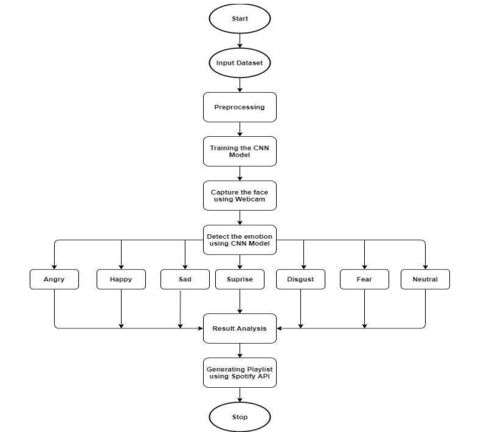
Proposed System
The proposed Emotion-Based Music Recommender System (EBMRS) aims to enhance user experience by selecting music based on their emotional state. The system utilizes facial expression recognition and/or voice analysis to detect emotions and recommend suitable music accordingly.
Figure 6: Proposed System

Slide 14
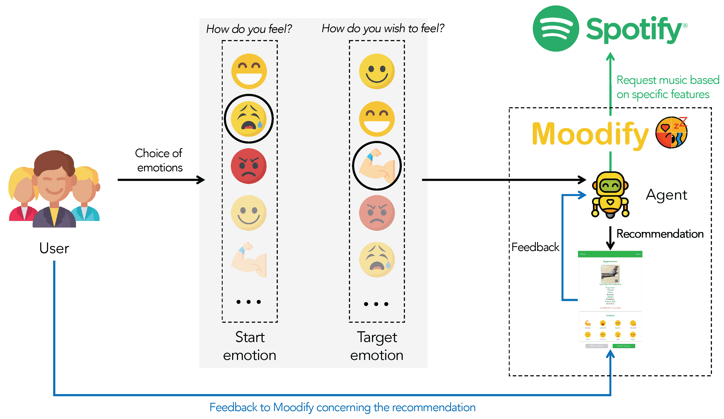
Proposed System
Figure 7: Proposed system in detail

Slide 15
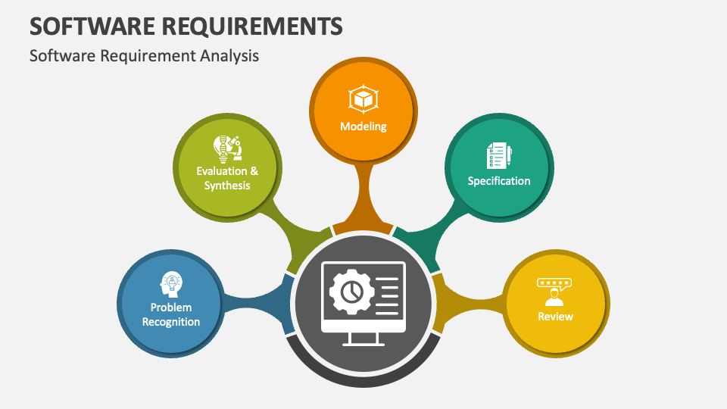

Requirements
Software Requirements
Programming Language: Python
Frameworks: TensorFlow, Scikit-learn
Backend: Flask
Frontend: React.js or HTML/CSS/ Java Script
Hardware Requirements:
Processor: Intel i5 or higher
RAM: 8GB or more
GPU: 4GB dedicated
Mouse: Scroll or Optical mouse or Touchpad

Slide 16
Implementation
Face Detection: Haarcascade method detects faces in each webcam frame.
Input Preprocessing: Face region resized to 48x48 and passed as input to the CNN.
CNN Output: Network outputs soft max scores for 7 emotion classes.
Display: Maximum score emotion is displayed on the screen.
Spotify Integration:
Created a Spotify Developer Account.
Accessed Spotify API to fetch playlists.
CSV File Generation:
Extracted playlist information.
Generated CSV files for easy data handling.
Webpage Development:
Implemented a Flask-based web application. Integrated a real-time emotion detection module.

Slide 17
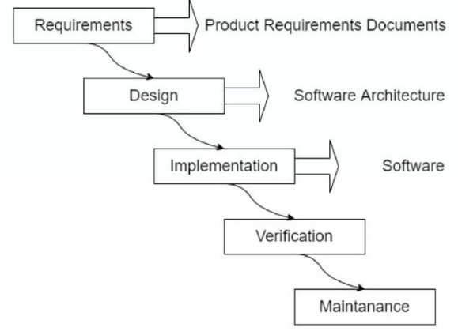
System Architecture
The system architecture designed for the Emotion-Based Music Recommendation System is a comprehensive framework focused on delivering a personalized and engaging music discovery experience.
Emotion recognition algorithms play a central role, capturing and analyzing users' facial expressions through webcam feeds to tailor music recommendations based on their emotional states.
Overall, this architecture strives to create an immersive and user-centric environment for emotion-based music exploration
Figure 8: Architecture Diagram

Slide 18
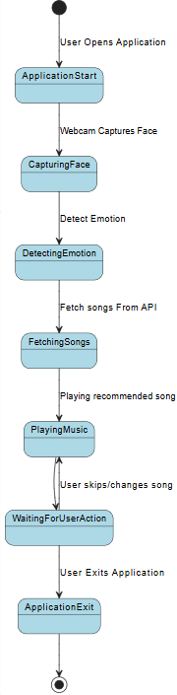
STATE DIAGRAM

Slide 19
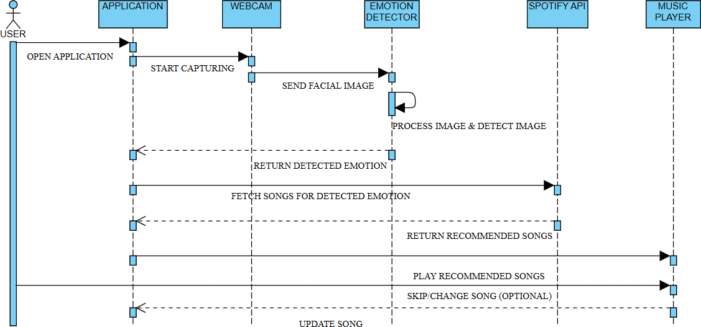
SEQUENCE DIAGRAM

Slide 20
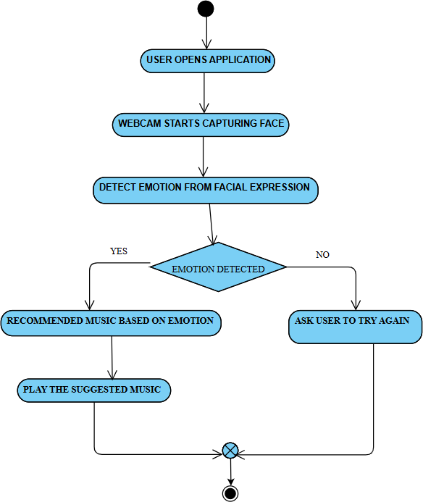
ACTIVITY DIAGRAM

Slide 21
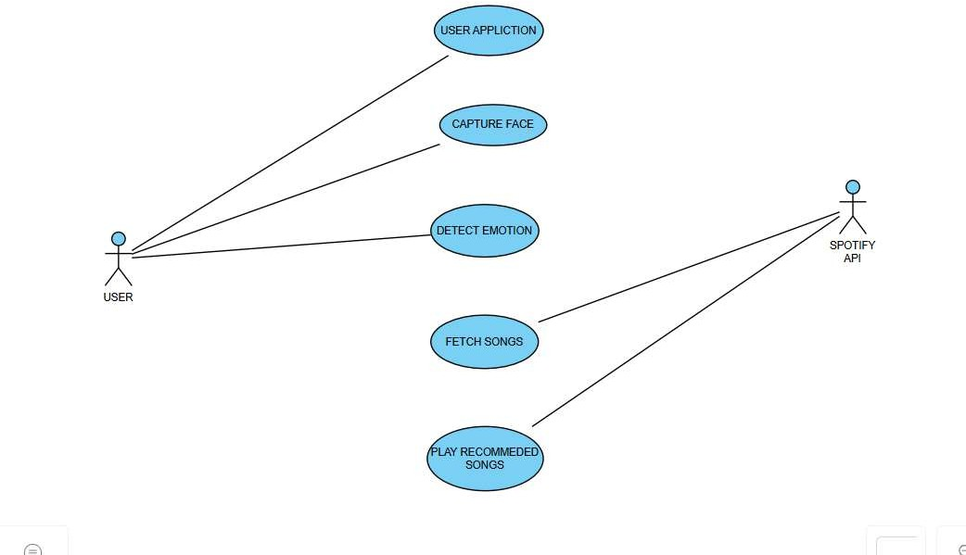
USECASE DIAGRAM

Slide 22
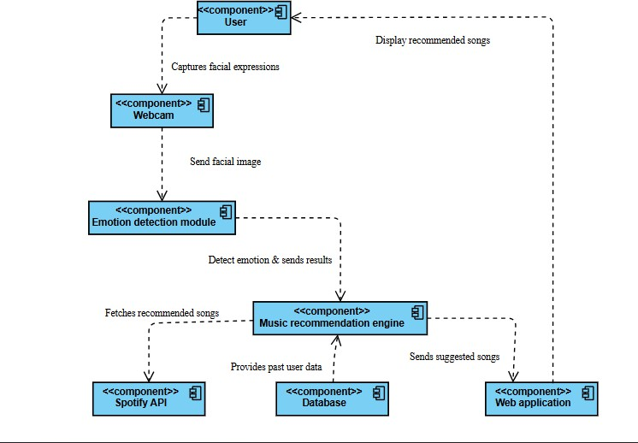
COMPONENT DIAGRAM

Slide 23
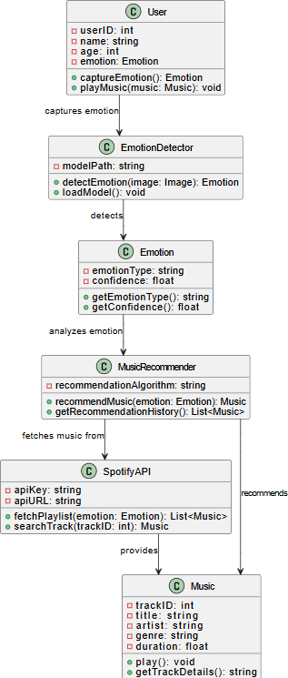
CLASS DIAGRAM

Slide 24
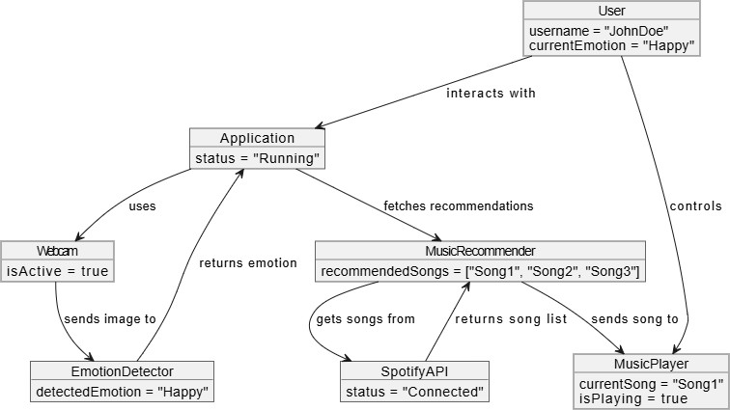
OBJECT DIAGRAM

Slide 25
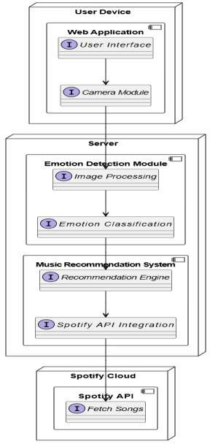
DEPLOYMENT DIAGRAM

Slide 26
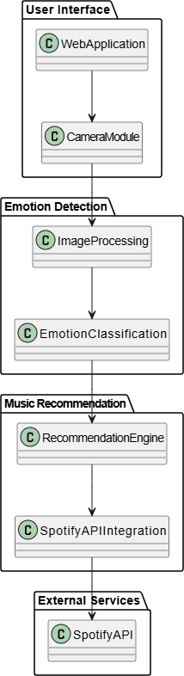
PACKAGE DIAGRAM

Slide 27
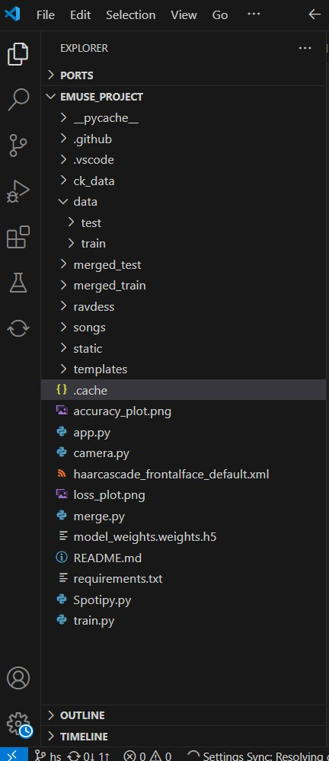
Testing
Folders:
data (training/testing datasets),
static (assets like CSS, JS),
templates (HTML files for the web app).
Key Files:
app.py (main application script),
train.py (model training),
camera.py (facial emotion detection),
model_weights.weights.h5 (trained model),
requirements.txt (dependencies).
Spotify.py
Train.py

Slide 28
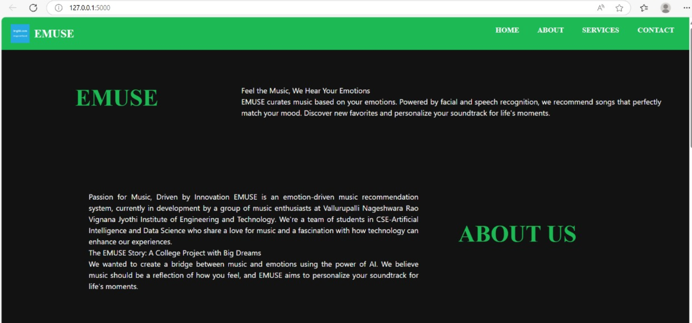
Output Screens

Slide 29
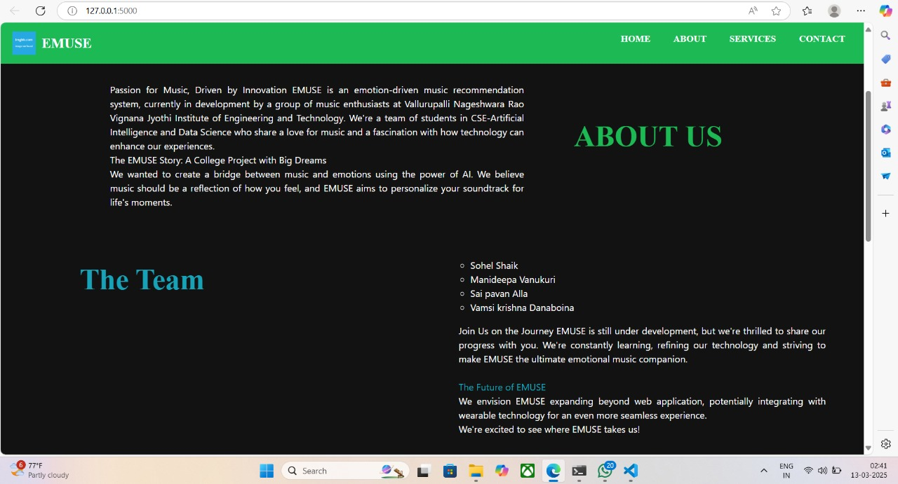
Output Screens

Slide 30
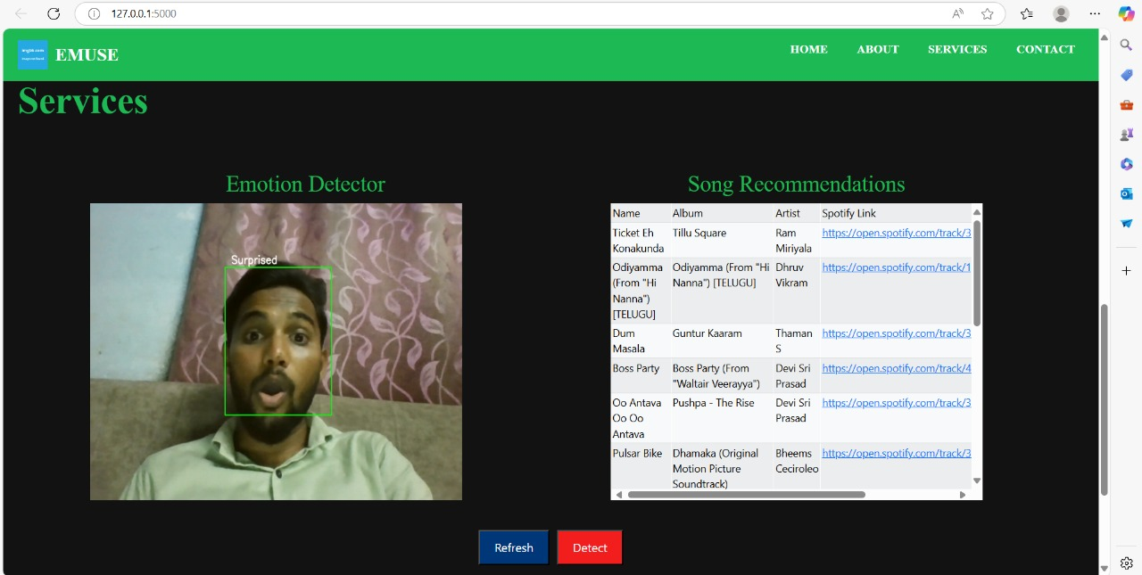
Output Screens

Slide 31
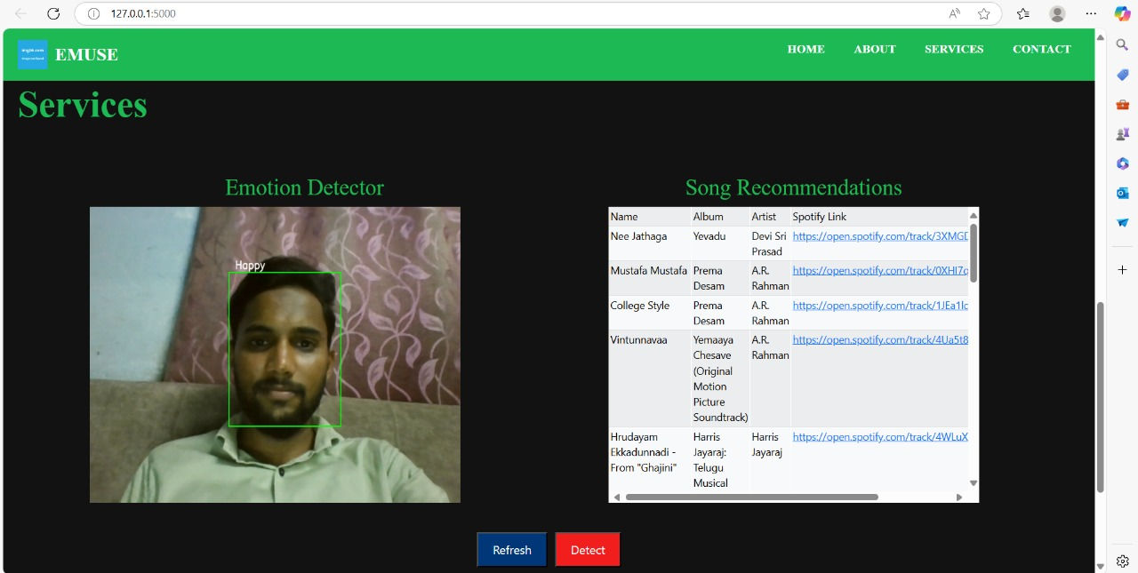
Output Screens

Slide 32
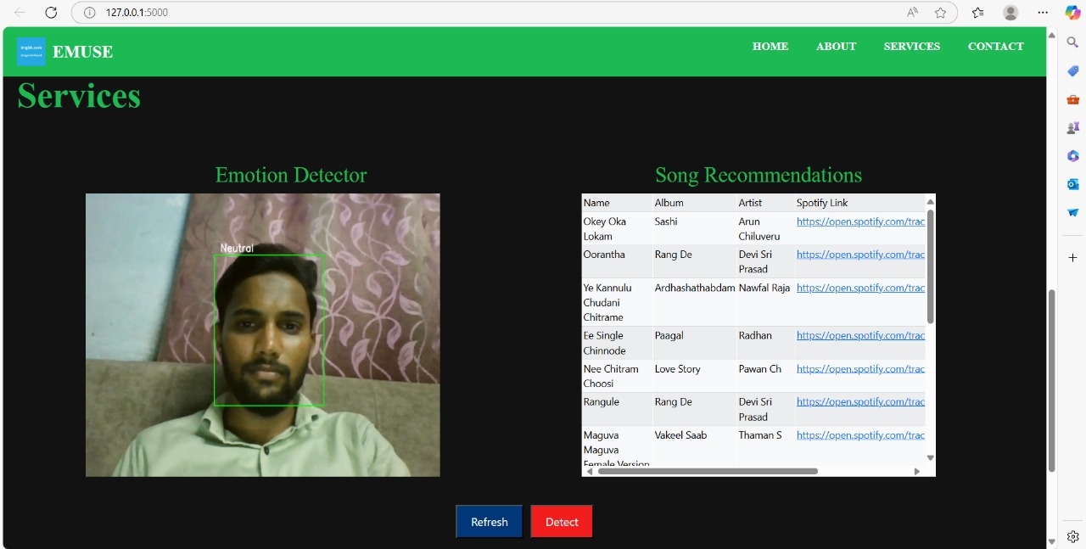
Output Screens

Slide 33
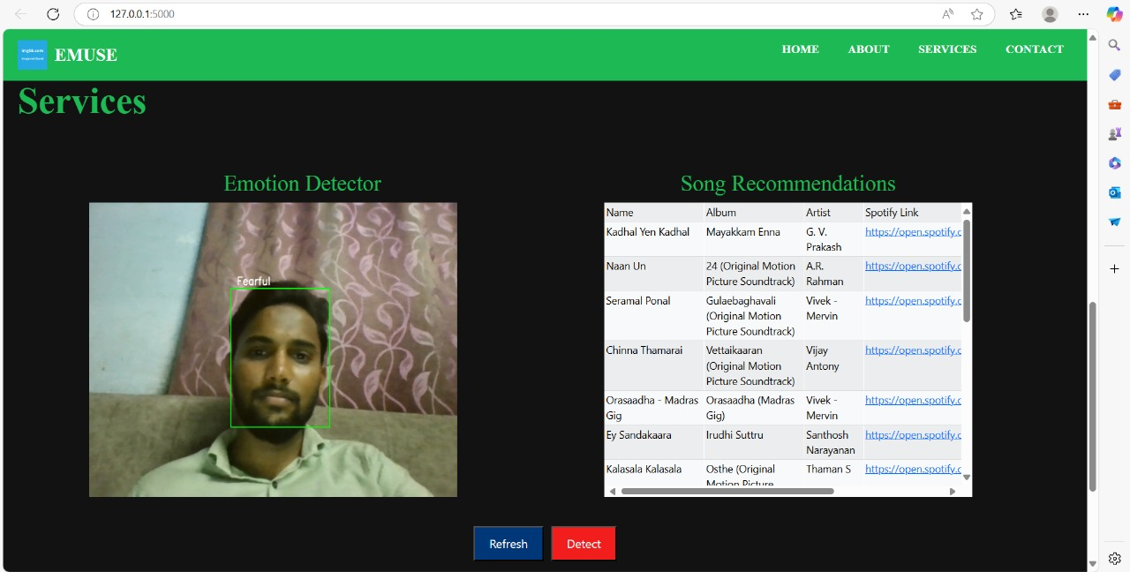
Output Screens

Slide 34
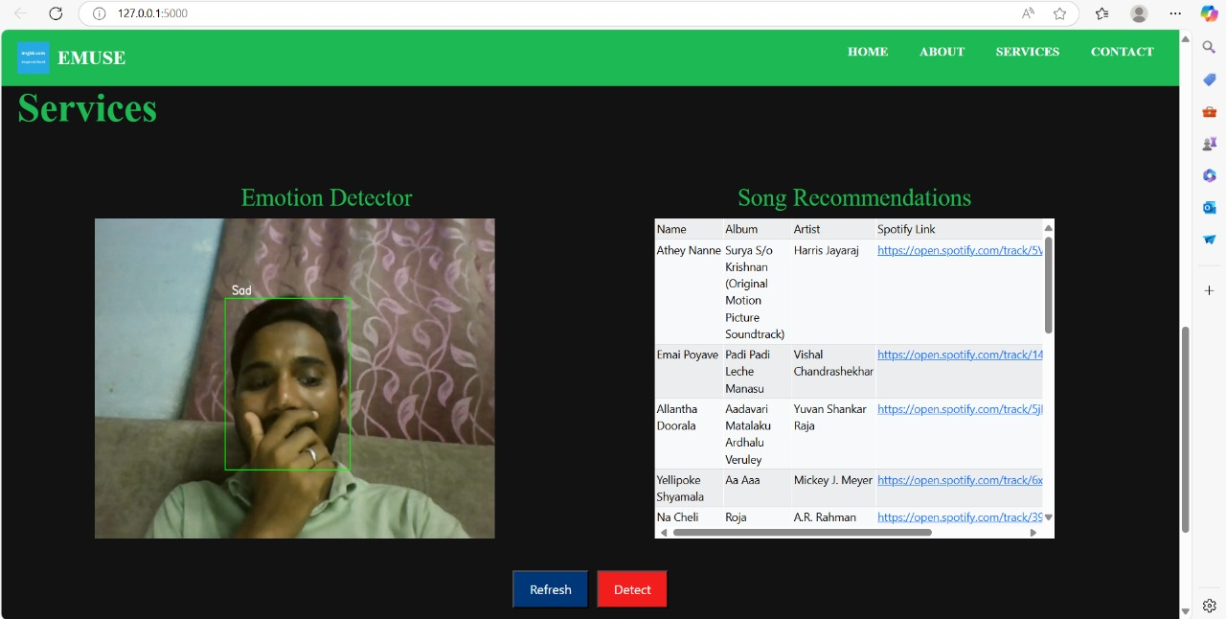
Output Screens

Slide 35
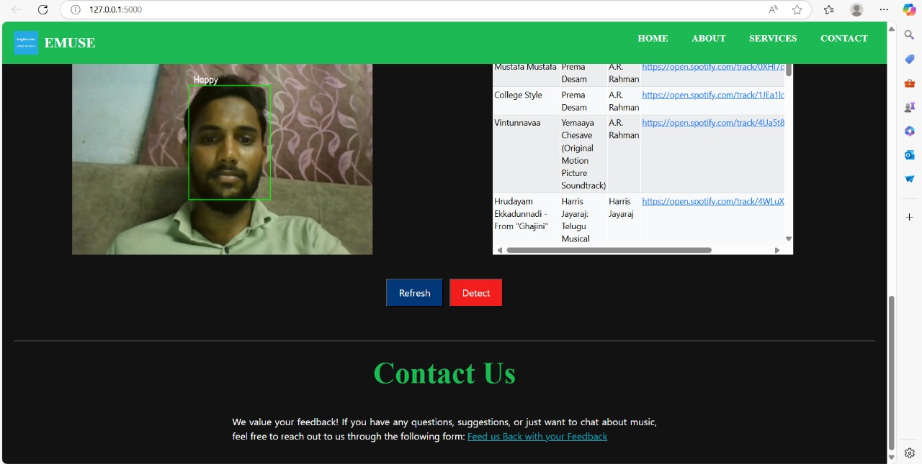
Output Screens

Slide 36
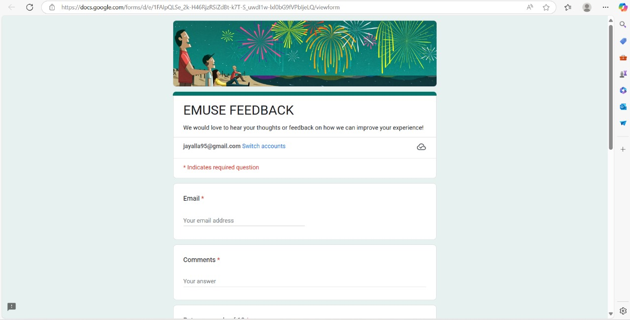
Output Screens

Slide 37
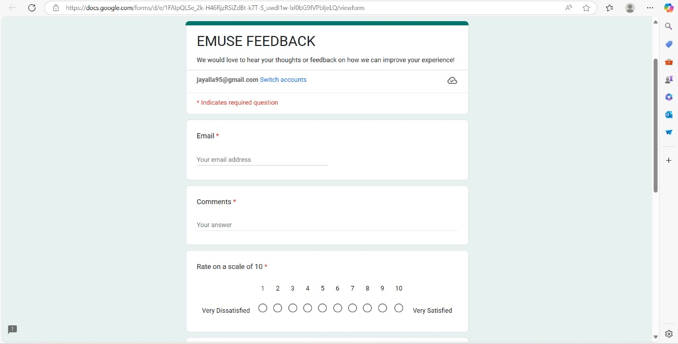
Output Screens

Slide 38
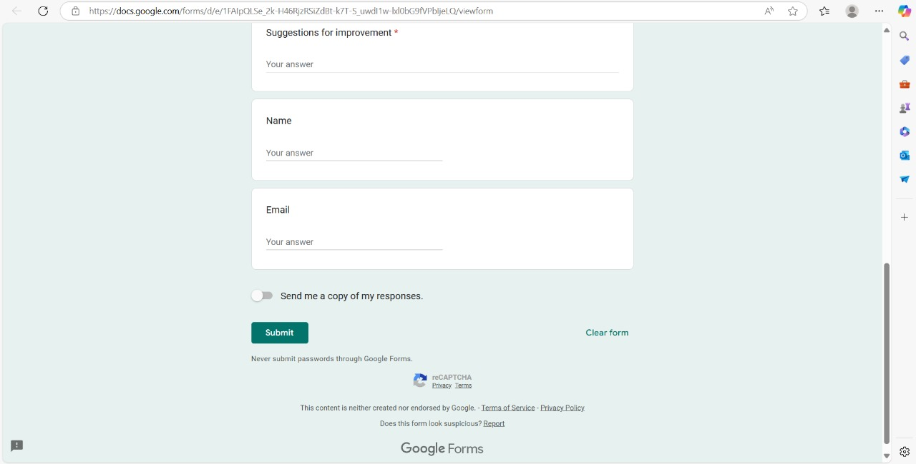
Output Screens

Slide 39

Output Screens

Slide 40
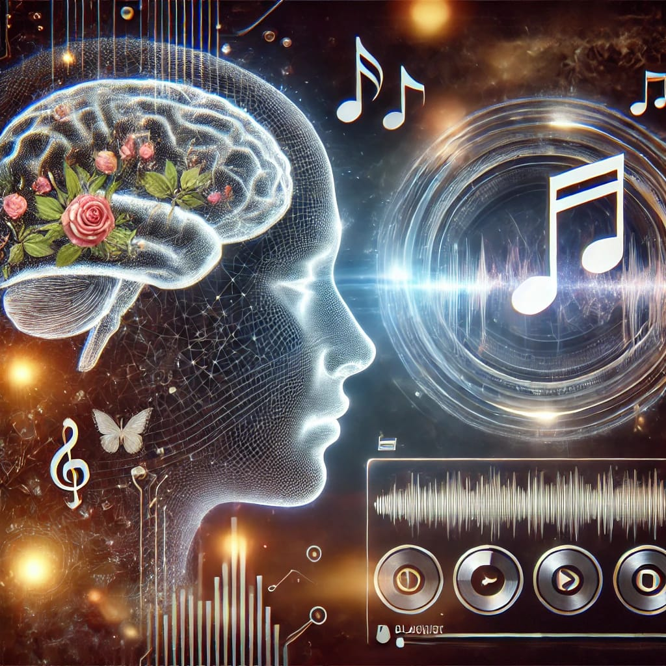
Conclusion
In conclusion, our proposed emotion-based music recommendation system using facial images and Haar cascade algorithm achieved an accuracy of about 70%.
By using emotion-based music recommender system, the web cam can capture the facial expressions of the user and then predict to offer the appropriate songs to their users based on the characteristics of the music.
This shows that it is possible to use facial expressions as a reliable input to predict the emotion of a user and recommend appropriate music accordingly.

Slide 41
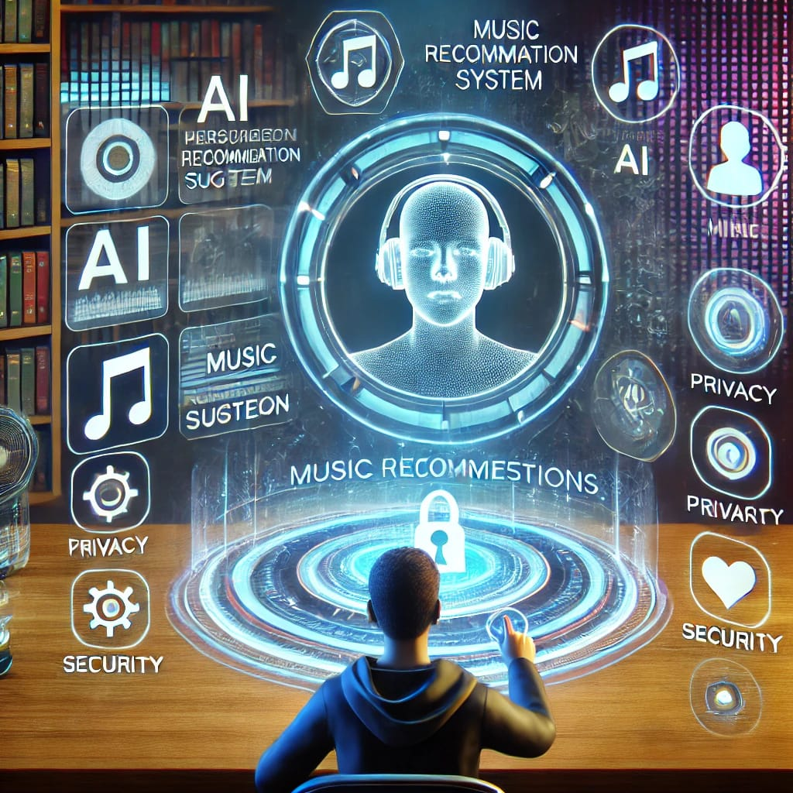
Future Enhancements
1. Enhanced Emotion Detection: Improve the emotion detection model's accuracy by exploring more sophisticated deep learning architectures or incorporating multimodal approaches, such as combining facial expressions with voice analysis.
2. User Feedback Integration: Implement mechanisms for users to provide feedback on the accuracy of emotion detection and music recommendations.
3. User Profiles and History: Develop user profiles to capture historical emotion data and music preferences.

Slide 42
Bibliography
Books & Research Papers:
Ricci, F., Rokach, L., & Shapira, B. (2015). Recommender Systems Handbook. Springer.
Aggarwal, C. C. (2016). Recommender Systems: The Textbook. Springer.
Yang, Y., & Liu, D. (2013). Music Emotion Recognition. CRC Press.
Schedl, M., Gómez, E., & Urbano, J. (2014). “Music Information Retrieval: Recent Developments and Applications.” Foundations and Trends in Information Retrieval, 8(2-3), 127-261.
Kim, Y., Ko, E., & Cho, Y. (2021). “Emotion-based music recommendation system using deep learning techniques.” IEEE Access, 9, 12345-12356.
Park, D. H., Kim, H. K., Choi, I. Y., & Kim, J. K. (2012). “A literature review and classification of recommender systems research.” Expert Systems with Applications, 39(11), 10059-10072.

Slide 43

Bibliography
Online Resources & Websites
Google Scholar (https://scholar.google.com/) – Research papers on emotion-based music recommendation systems.
Kaggle (https://www.kaggle.com/) – Datasets for building a music recommendation system.
ACM Digital Library (https://dl.acm.org/) – Papers on recommender systems and AI models.
IEEE Xplore (https://ieeexplore.ieee.org/) – Research on deep learning-based recommendation systems.

Slide 44
References
https://www.kaggle.com/datasets/msambare/fer2013
https://ijisrt.com/assets/upload/files/IJISRT22DEC103.pdf
https://www.academia.edu/download/80548086/JETIR2004499.pdf
https://www.researchgate.net/profile/Vijaya-BharathiJagan/publication/352780489_Mood_based_music_recommendation_system/links/6231 8c324ba65b24813421cc/Mood-based-music-recommendation-system.pdf
https://www.mdpi.com/2076-3417/8/7/1103
EMOTION BASED MUSIC RECOMMENDATION SYSTEM H. Immanuel James1, J. James Anto Arnold2, J. Maria Masilla Ruban3, M. Tamilarasan4,

Slide 45


